Slide 1
TIM 245 Project Proposal SF Crime Classification
Borui Wang
Han Chen
Notes:
This presentation demonstrates the new capabilities of PowerPoint and it is best viewed in Slide Show. These slides are designed to give you great ideas for the presentations you’ll create in PowerPoint 2011!
For more sample templates, click the File menu, and then click New From Template. Under Templates, click Presentations.

Slide 2
Enhancing Your Presentation
1
2
3
Classification and Data Visualization
Different Algorithms for Classification
Questions

Slide 3
Classification and Data Visualization
1

Slide 4

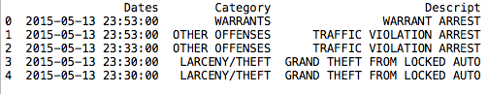
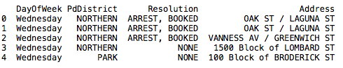
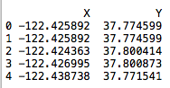
Overview of Dataset
There’re 7 attributes in the dataset. More than 1,600k records from 2003-01-01 to 2015-05-13.
There’re 39 kinds of Category, 879 kinds of Descript, 17 kinds of Resolution.
Wrong coordinates.(< -122)

Slide 5

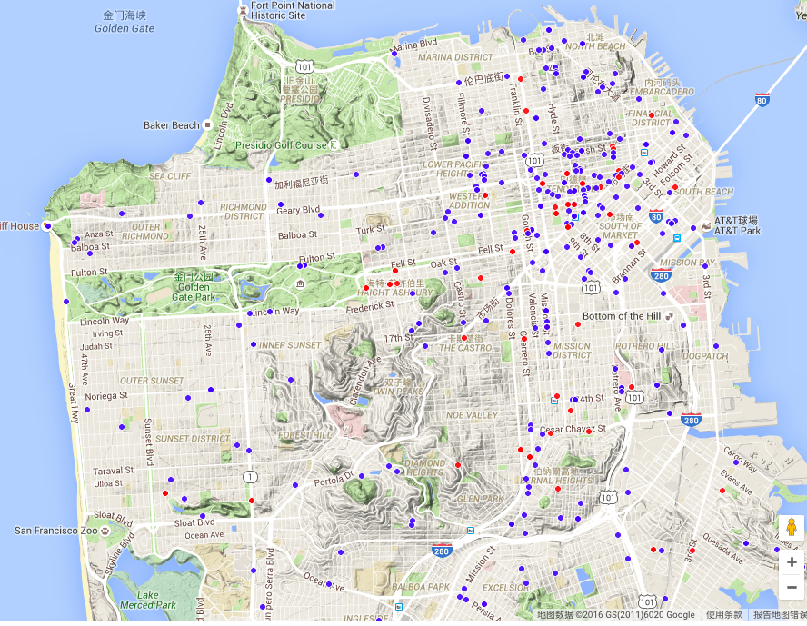
Data on 2015-05-13
Organize with Sections

Slide 6

Enrich Your Presentation
2
Stylize, edit, and animate your media

Slide 7


YOUR MESSAGE.
It’s not just about the visuals, but strengthening

Slide 8



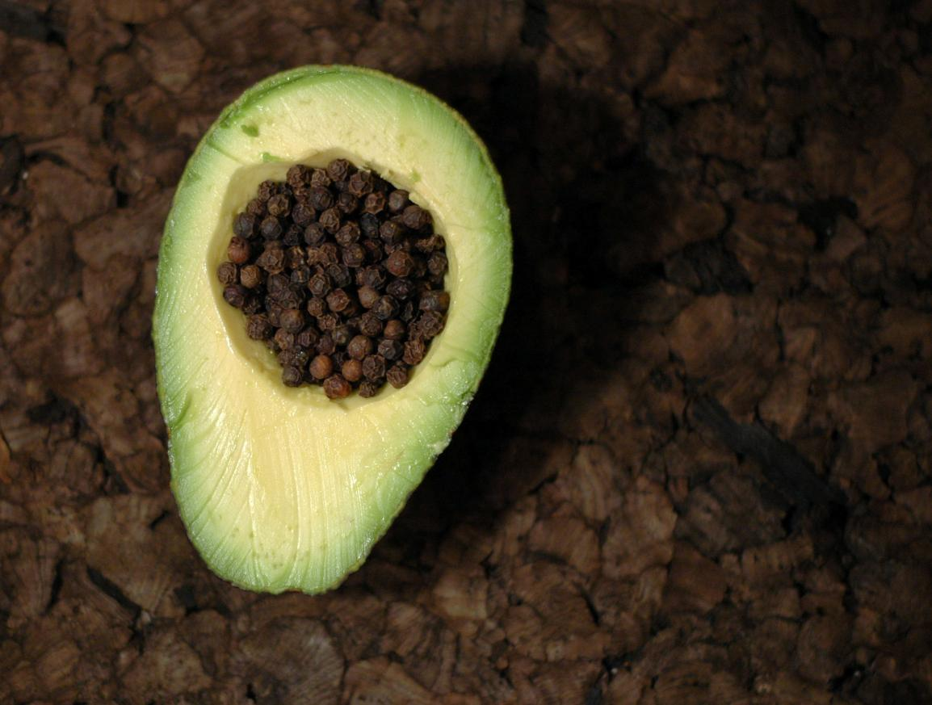

New Picture Effects
Picture Color, Corrections, Artistic Filters,
and Background Removal allow you to customize images for your story

Slide 9


Movie Perfect
You can do a lot more with movies in PowerPoint 2011.
Movies can be embedded in your presentation. That’s right, no more lost movies!
Also, you can recolor the entire movie or apply a movie style easily. Your movies will look great!

Slide 10
What about the beautiful transitions you’ve been seeing?
Exciting new transitions
They are new too.

Slide 11
Share Your Presentation
3
View your slides from anywhere!

Slide 12





Collaboration
Simultaneous edits on one single document. No more waiting your turn or managing multiple versions.
It’s about team work, and co-authoring will get you there.

Slide 13

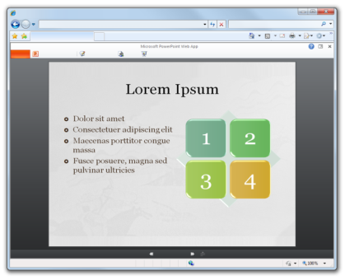

Access Anywhere
Check out the
PowerPoint Web App
Access slides wherever you are

Slide 14





POWERPOINT 2011
What’s Your Message?

